Slide 1
IoT Air Quality System
Jacob Mb. Taamté (mtjfirst@yahoo.fr)
ThingSpeak Platform Presented at the Workshop – IoT4AQ
March 2024, Bambey, Sénégal

Slide 2
ThingSpeak Platform
ThingSpeak is open source software written in Ruby that allows users to communicate with internet-enabled devices, better known as the Internet of Things. It facilitates data access, retrieval and logging by providing an application programming interface (API) to devices and social media websites. ThingSpeak was originally launched by ioBridge in 2010 as a service to support IoT applications.
ThingSpeak has integrated support for MathWorks MATLAB numerical computing software, allowing ThingSpeak users to analyze and visualize uploaded data using MATLAB without requiring the purchase of a MATLAB license from MathWorks.

Slide 3
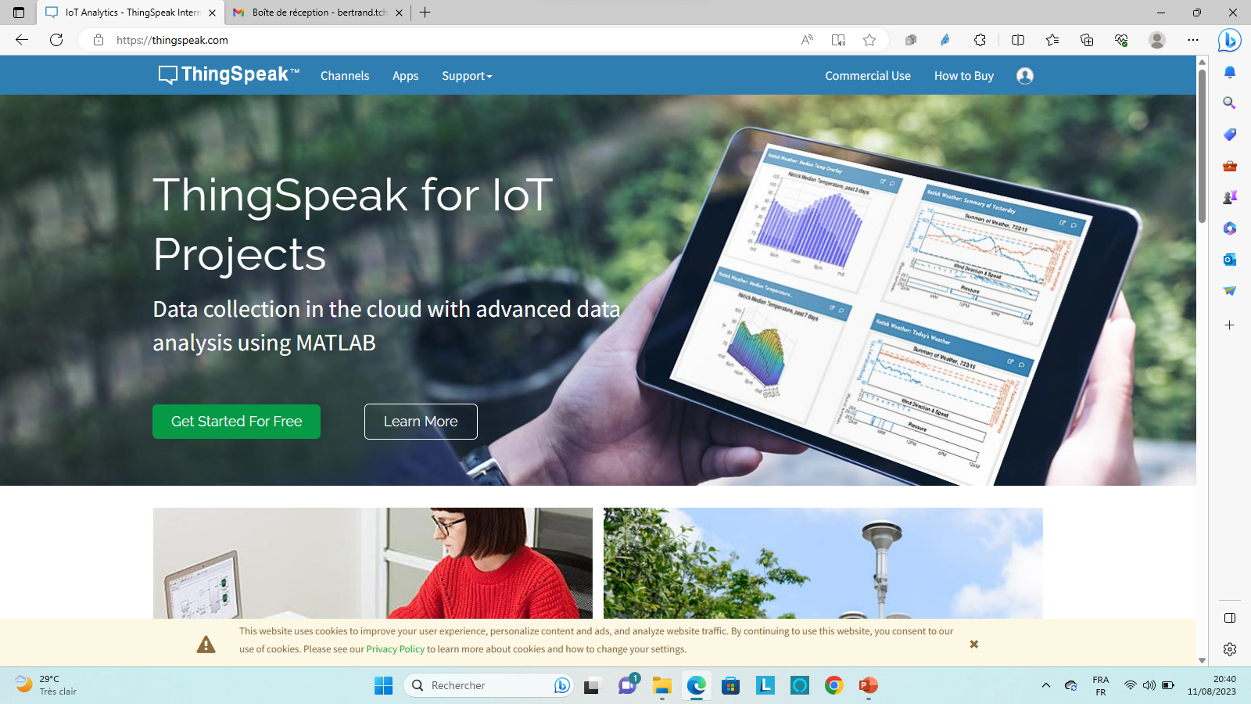
ThingSpeak Platform

Slide 4
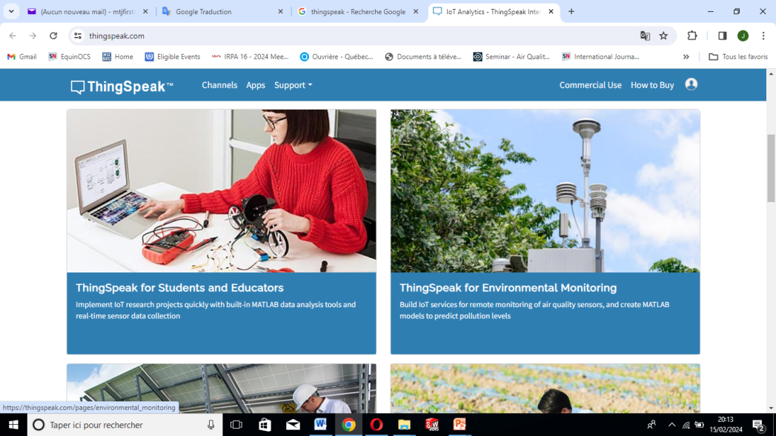
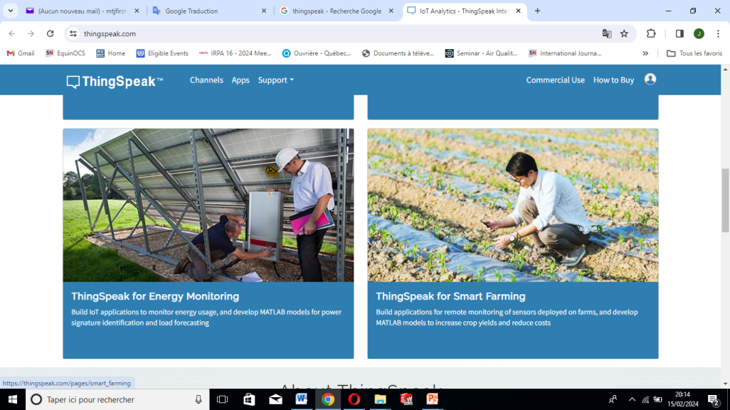


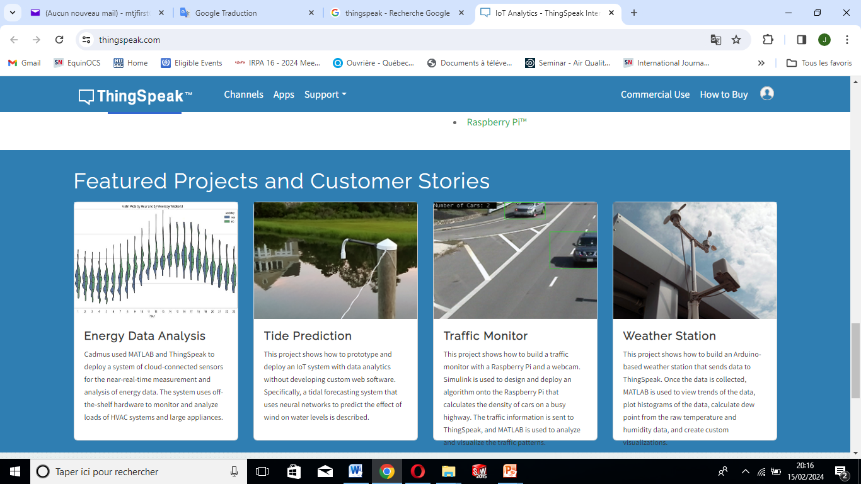
Features of ThingSpeak
ThingSpeak Features
Collect data in private channels ;
Share data with public channels ;
RESTful and MQTT APIs;
MATLAB analytics and visualizations ;
Event scheduling ;
Alerts ;
App integrations ;

Slide 5
ThingSpeak – Getting Started
Go to ThingSpeak (https://thingspeak.com/) and click the “Get Started For Free” button to create a new account. And to create a ThingSpeak account, we will use our email address.
This account is linked to a Mathworks account. So, if you already have a Mathworks account, then you should log in with that account.

Slide 6
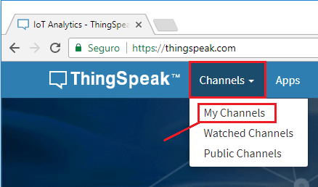
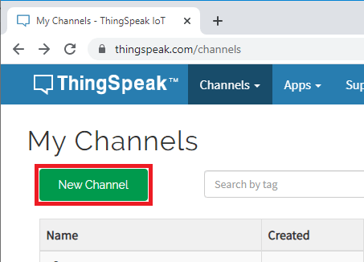
ThingSpeak – Getting Started
1. We need to create an account
2. Create your channels

Slide 7
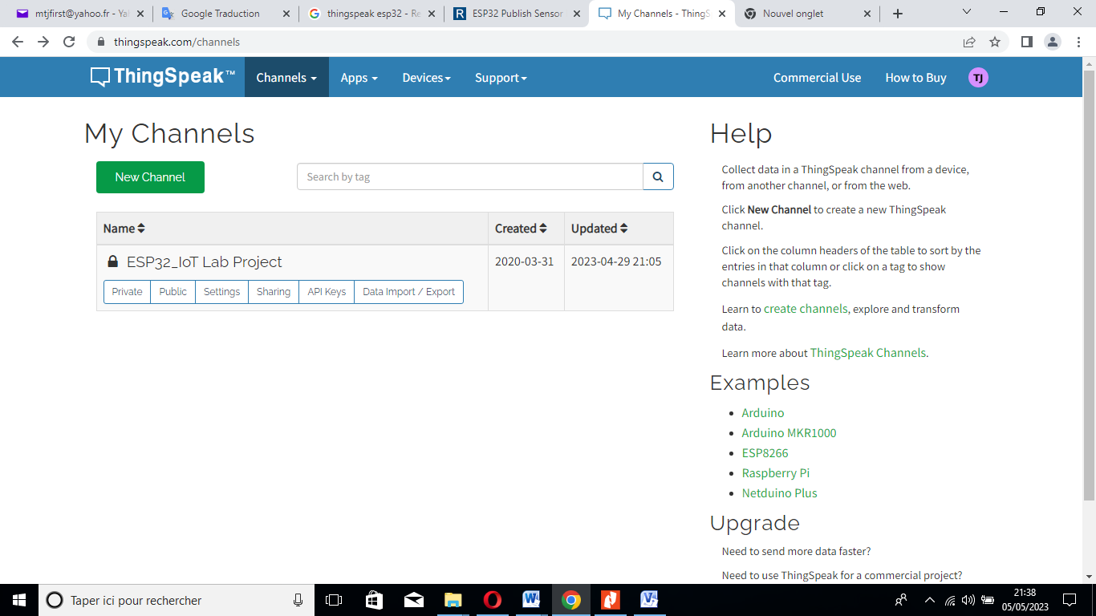
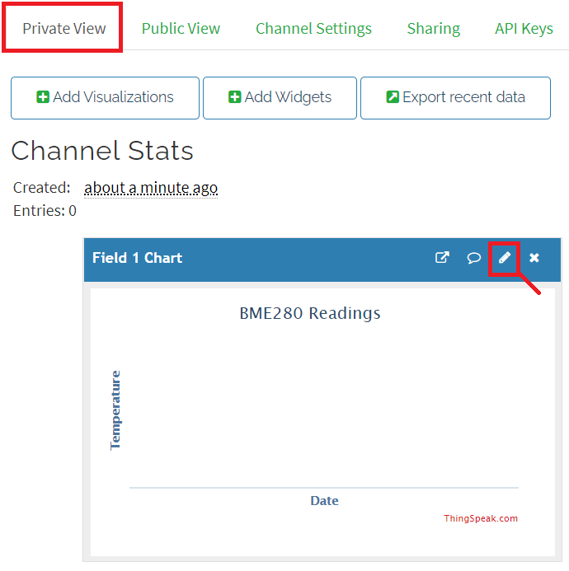
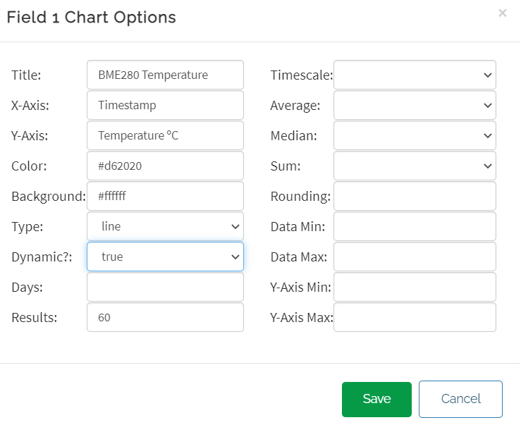
ThingSpeak – Getting Started
3.Type the name of the channel and add a description

Slide 8
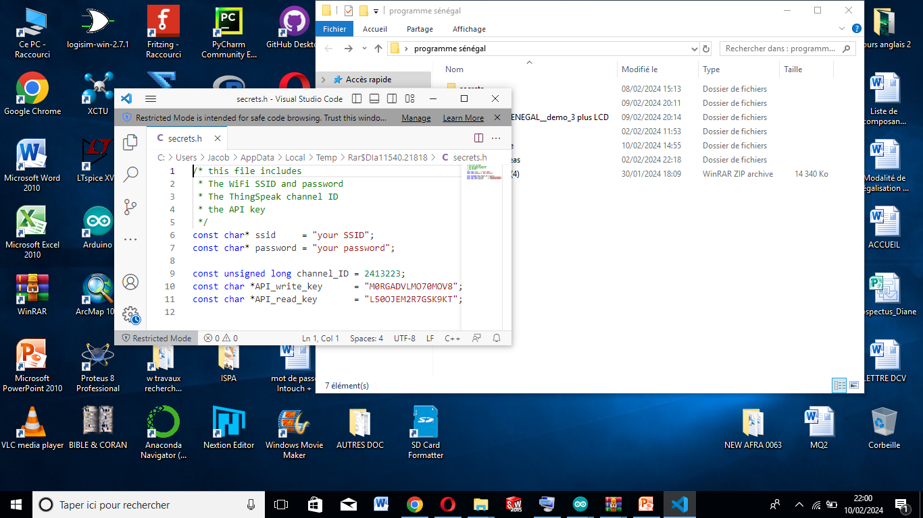
Connect the system to the ThingSpeak Cloud Plateform
4. Generate the API keys which will be customized in the working code

Slide 9
How to connect the system to ThingSpeak platform
We will learn how to install the library and try to connect the measurement system to the ThingSpeak platform to visualize the data on the Cloud.
Step 1: Installing ThingSpeak Library for ESP32
Library : https://github.com/mathworks/thingspeak-arduino
This library is tested for ThingSpeak with ESP32.

Slide 10
How to connect the system to ThingSpeak platform
Step 2: Code ESP32 for ThingSpeak Cloud Plateform with :
thingSpeakBasic.ino
thingSpeak_demo.ino

Slide 11
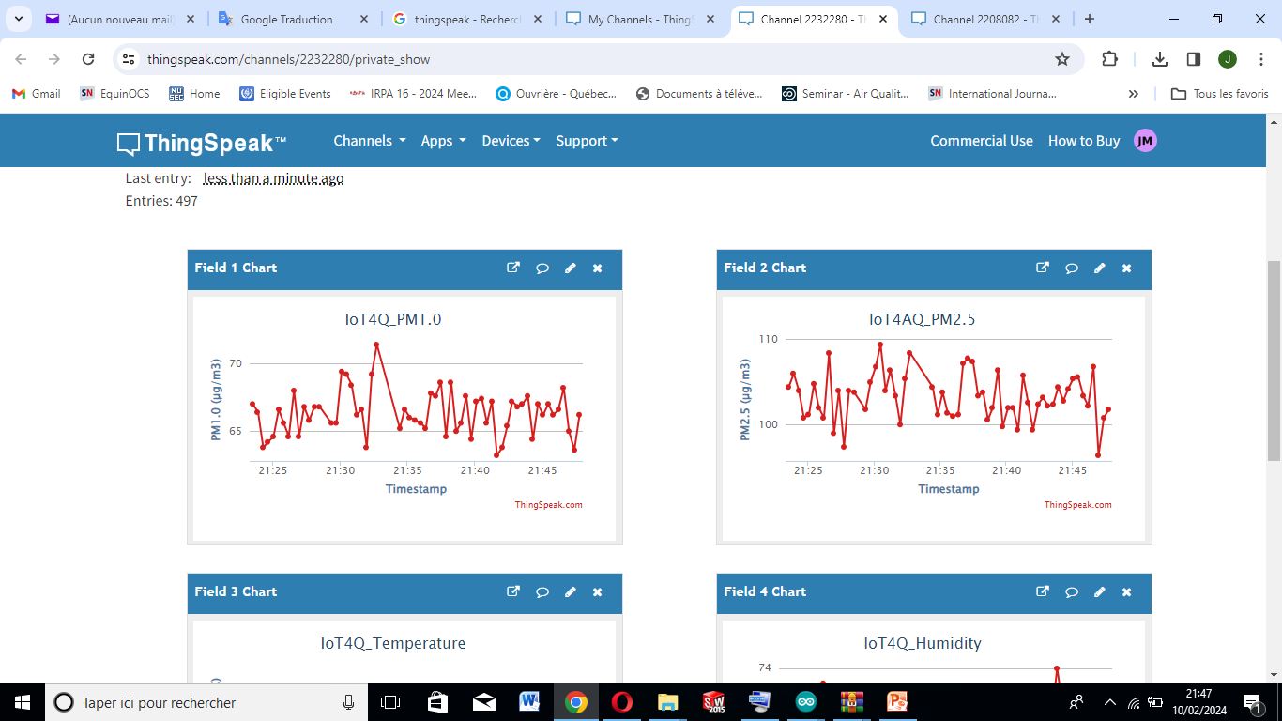
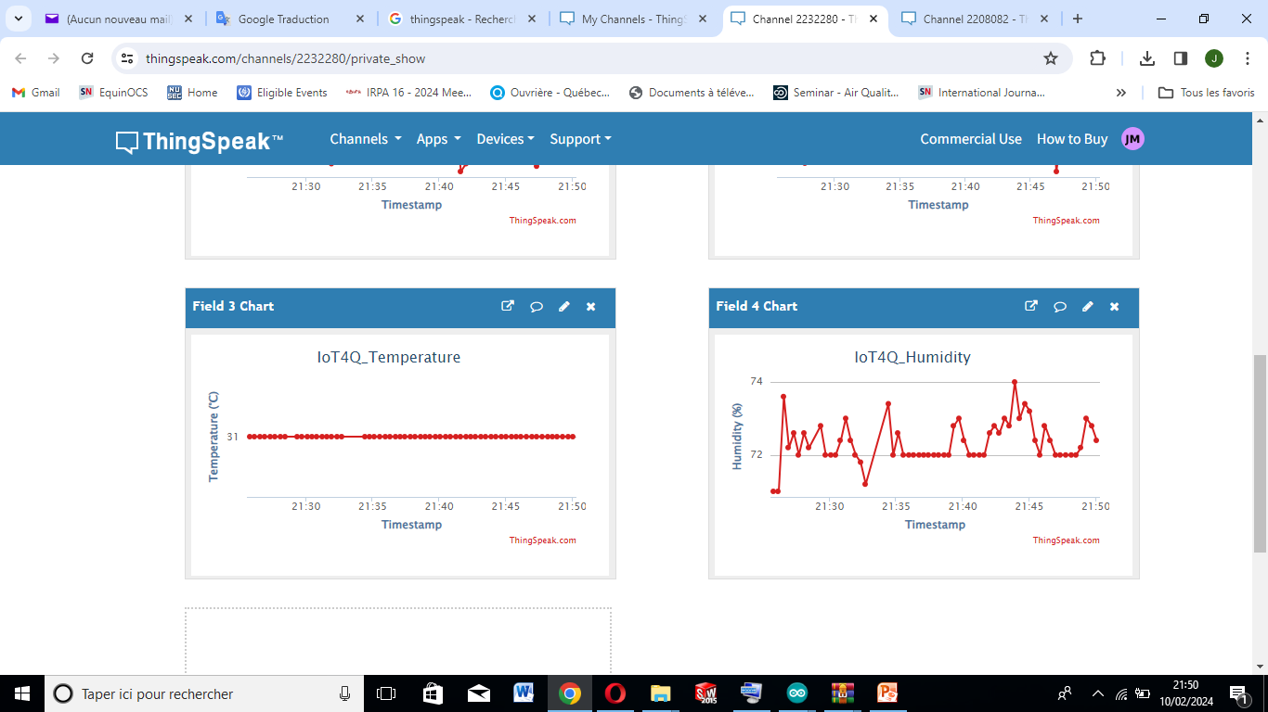
Real-time data evolution on the Thingspeak platform
PM1.0 (µg/m³)
PM2.5 (µg/m³)
Temperature (°C)
Relative Humidity (%)

